Slide 1
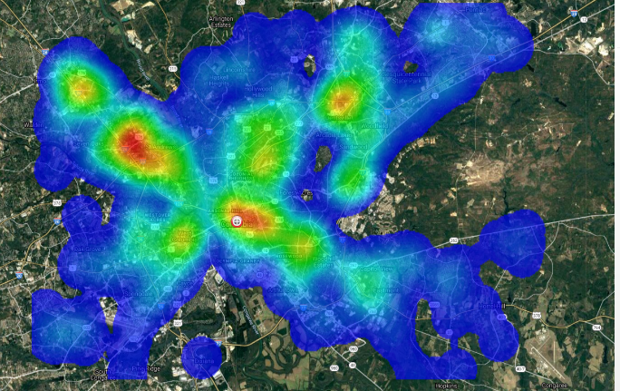
Off-Post Crime
Top 5 Off-Post Crimes
Burglary from a vehicle
Motor vehicle theft
Assault - Other
Theft
Aggravated Assault
7
2
5
6
3
Fort Jackson
1
4
YOU ARE HERE
1. 5-Points area (night light area near college) (Gervais/Harden/Devine Streets)
2. 2-Notch / North Trenholme Decker Blvd
3. Forest Drive / Percival Road (Area outside of ACP 2)
4. Garners Ferry Rd (7200 – 7600 Blocks)
5. St. Andrews Rd/I-26/Broad River Rd
6. W. Beltline Blvd/Bailey St area
7. Harbison Blvd area (Shopping Mall area)
Low
Criminal Incident Concentration
High
Off-Post High Crime Times
Saturday Night
Thursday Evenings
Monday Evenings

Slide 2
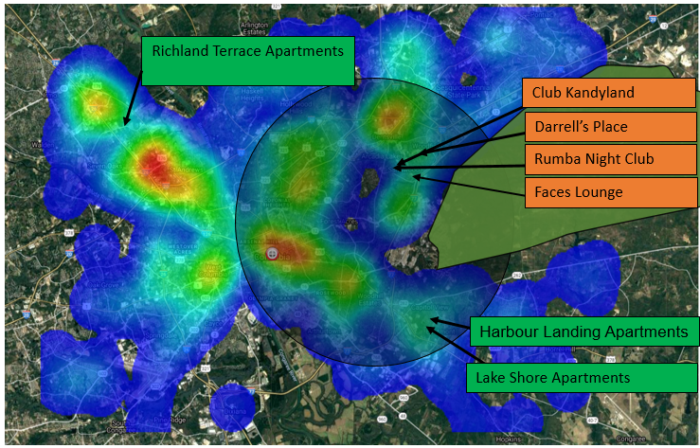
FJ Off-Limit Establishments
CAN BE FOUND ON FORT JACKSON WEBSITE!!
Off-Limit Establishments
1. Club Kandyland
2. Faces Lounge
3. Darrell’s Place
4. Rumba Night Club
5. Richland Terrace Apartments
6. Harbour Landings Apartments
7. Lake Shore Apartments
Tropical Breeze Bar and Grill
My Place
Hookah on the River
Rose Gold
Exquisite Events Center
Dab City Tobacco and Vape
CBD Farmacy
Temporary Off-Limit Establishments
1. 6912 Cabin Creek Road
2. 2700D Broad River Road, Hookah on the River
3. 2700A Broad River Road, Exquisite Events Center
4. 1004 Zimalcrest Dr., Tropical Breeze Bar and Grill
5. 7720 Claudia Dr., My Place
6. 2219 Broad River Road., Rose Gold
7. 3722 River Drive., Tropical Breeze Bar and Grill
8. Dab City Tobacco & Vape 5496 A, Forest Drive, Columbia, South Carolina 29206
9. CBD Farmacy, 3407 Forest Drive, Columbia, SC 29206
10. Purple Haze Smoke Shop, 719 Saluda Ave, Columbia, SC 29205
Purple Haze Smoke Shop
6912 Cabin Creek Rd.
Off-Limit - Bar
Off-Limit - Apartment
Temporary Off-Limits
CBD Shops
Note:
Club Kandyland- (closed as of spring 2019) (Drug/Criminal Activity)
Faces Lounge- (closed as of spring 2019) (Drug/Criminal Activity)
Darrell’s Place- (closed as of winter 2018) (Drug/Criminal Activity)
Rumba Night Club (Drug/Criminal Activity)
Richland Terrace Apartments (Pest infestation, high crime)
Harbour Landing Apartments (Multiple shootings)
Lake Shore Apartments (Multiple shootings)

